Slide 1

Creating an LLM Chatbot for Business Analysis Using the BABOK
Presented by
Vaishakhi Shah
10th December 2024

Slide 2

Applied Project
Presentation in fulfillment of requirements of the NYU SPS for the degree of Master of Science in Management and Systems
Applied Project: Capstone
Fall, 2024

Slide 3
Project Sponsor And Project Goals
PROJECT SPONSOR:
Capstone Project on Creating an LLM Chatbot for Business Analysis Using the BABOK.
The Digital Forge (Education Lab at NYU), NYU School of Professional Studies and the Management and Systems program (MASY) is a New York-based learning institution.
Dr. Andres Fortino, Clinical Associate Professor, NYU (https://www.linkedin.com/in/afortino), The Client.
PROJECT GOALS:
The primary objective of this project is to create a chatbot that guides business analysts through the process of technology adoption and business analysis planning by utilizing the BABOK.
Another objective of the project is to conduct initial trials applying the chatbot to various business analysis cases and compare its output to traditional methods.
These trials will assess factors such as the relevance of the proposed solutions and time efficiency to determine the chatbot's overall effectiveness in real-world business analysis scenarios particularly in the rapidly evolving landscape of technology adoption and project planning.

Slide 4

What Did The Project Need To Achieve ?
Project Objectives & Metrics for measuring project success:
Objective #1: Deliver a functional requirement specification document and confirm the expected function with the client.
Measurement: The final version is due by 17th September 2024
Objective #2: Provide the technical design document including Data sources, Machine learning model, and testing methodology.
Measurement: The design document final version is due by 8th October 2024
Objective #3: Design and Develop the LLM Chatbot using BABOK guide.
Measurement: The design and development of Chatbot is due by 22nd October 2024
Objective #4: Trial Testing for the Harvard test case scenarios provided by the client.
Measurement: The chatbot is ready for testing due by 5th November 2024
Objective #5: Deploy and Validate the LLM Chatbot.
Measurement: The deployment and validation are due by 3rd December 2024

Slide 5
What Is Required To Be Done?
To achieve the objectives for the LLM Chatbot using the BABOK guide project:
Phase 1: Functional Requirement Specification | Conducted stakeholder meetings to gather and confirm detailed requirements. Created a comprehensive requirements document.
Phase 2: Technical Design Document | Identified data sources and selected a machine learning model architecture. Documented design specifications and testing methodologies.
Phase 3: Chatbot Design and Development | Developed an intuitive user interface and integrated BABOK guide content. Completed chatbot development to enable effective query responses.
Phase 4: Trial Testing and Deployment | Conducted trial testing using Harvard test case scenarios and refined the chatbot based on feedback. Deployed and validated the chatbot, meeting client expectations and project goals.

Slide 6
Results
A custom-built LLM chatbot with 2 Proof of Concepts along with its Pros and Cons (using Python and Juji Studio) Options for the implementation and delivering the Chatbot for the client to have Business Analysis decisions.
A working prototype of the chatbot which is developed, capable of processing case inputs and generating plan suggestions.
Effective and Efficient solutions to business analysts in comparison to traditional methodology.
Using Python
Pros - High flexibility, scalable, customizable
Cons – Longer development time, requires coding expertise , API request Cost $5 for 500 requests + Ngrok website hosting cost as per different plans, the payments are associated (average $8 p/m)
Using Juji Studio
Pros - Rapid development, user-friendly interface
Cons – Limited customization, scalability challenges, Deployment cost $50 for 14 days trial reimbursed if subscribed for a year. (Start-up plan 250 chat sessions p/m included)
“While both the responses address the questions asked and gives the useful and relevant solution, Response 1 for each question where, the use of Python LLM Chatbot offers a broader, more generalized approach whereas Response 2 for each question where, the use of Juji Studio Chatbot appears more specific to the case scenario. Let’s see another example below with different objective and purpose.”
Source Link: GitHubLink

Slide 7
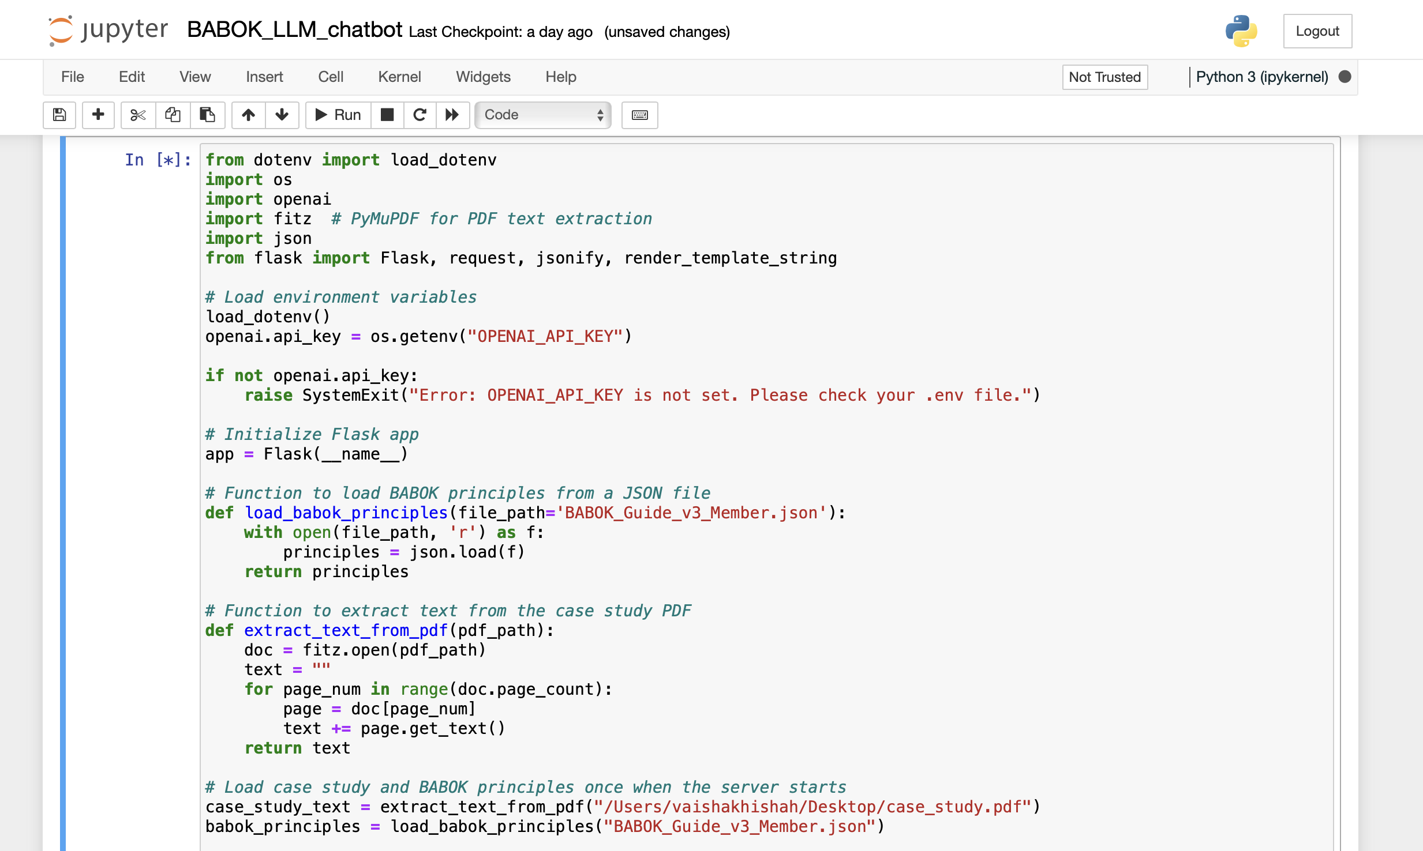
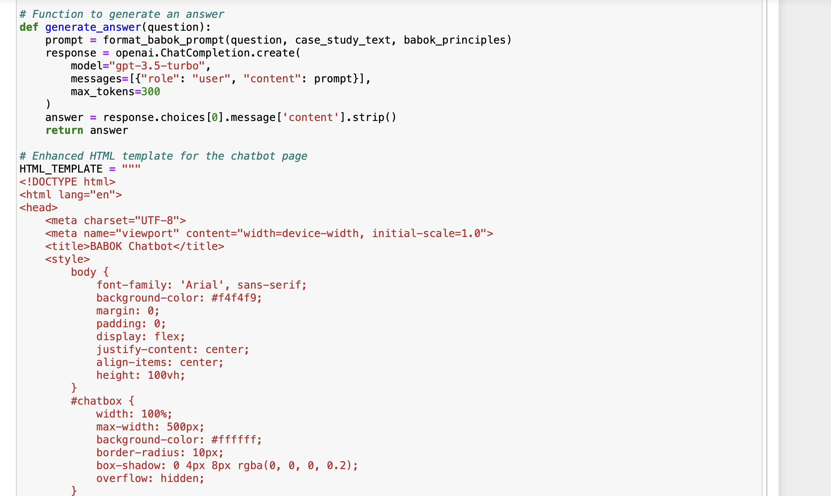
Results
1: Using Python
Source Link: http://localhost:8889/notebooks/Desktop/NYU/Sem4_Sept24_fall/Assignments/5/BABOK_LLM_chatbot.ipynb

Slide 8
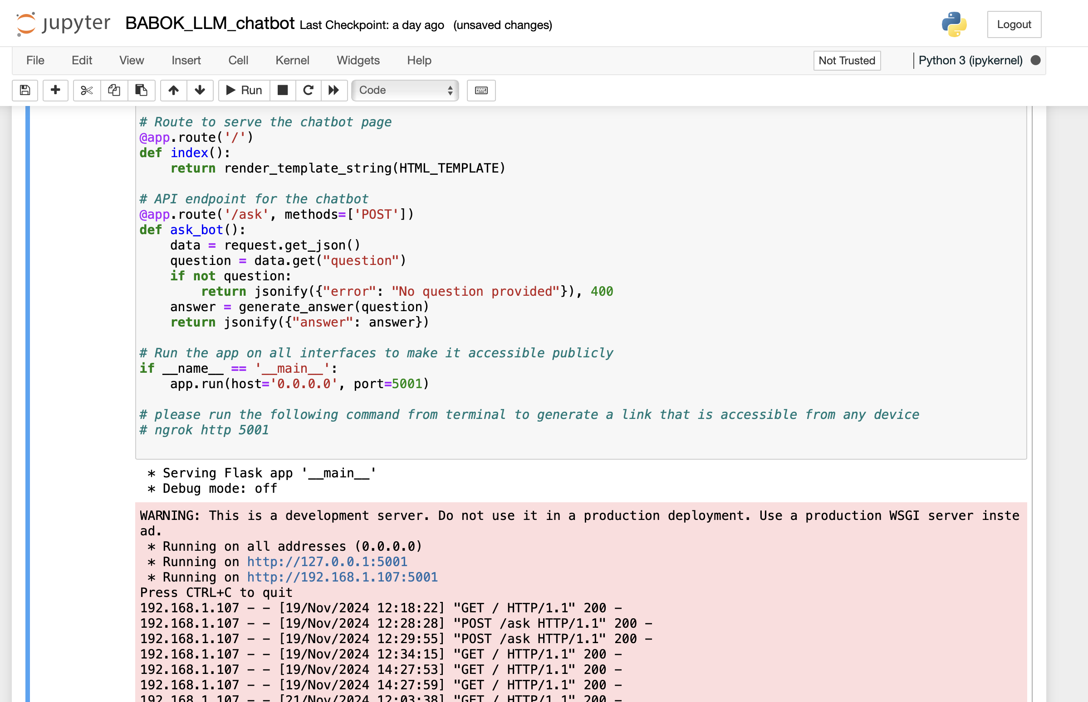
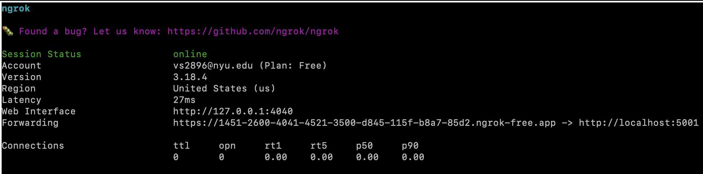
Results
1: Using Python
Source Link: http://127.0.0.1:5001/
Source Link: https://5c0b-2600-4041-4521-3500-f06b-5a12-ad81-dd59.ngrok-free.app

Slide 9
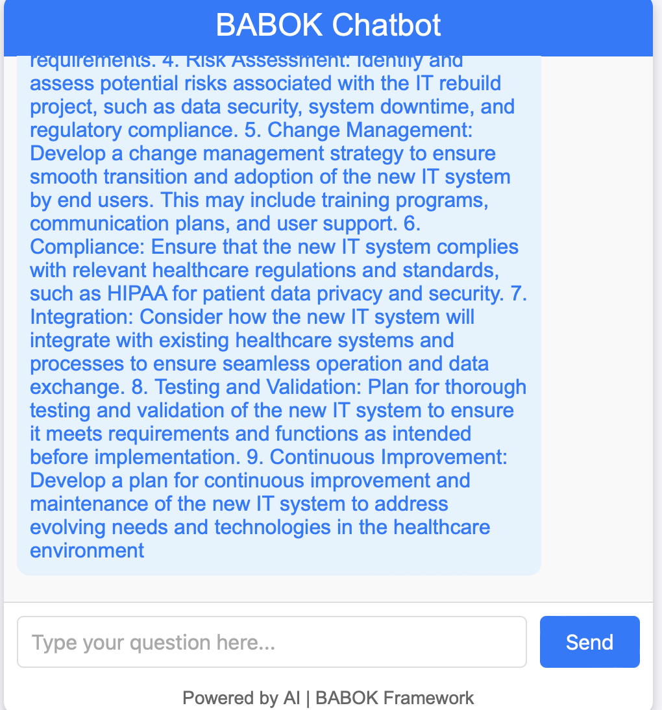
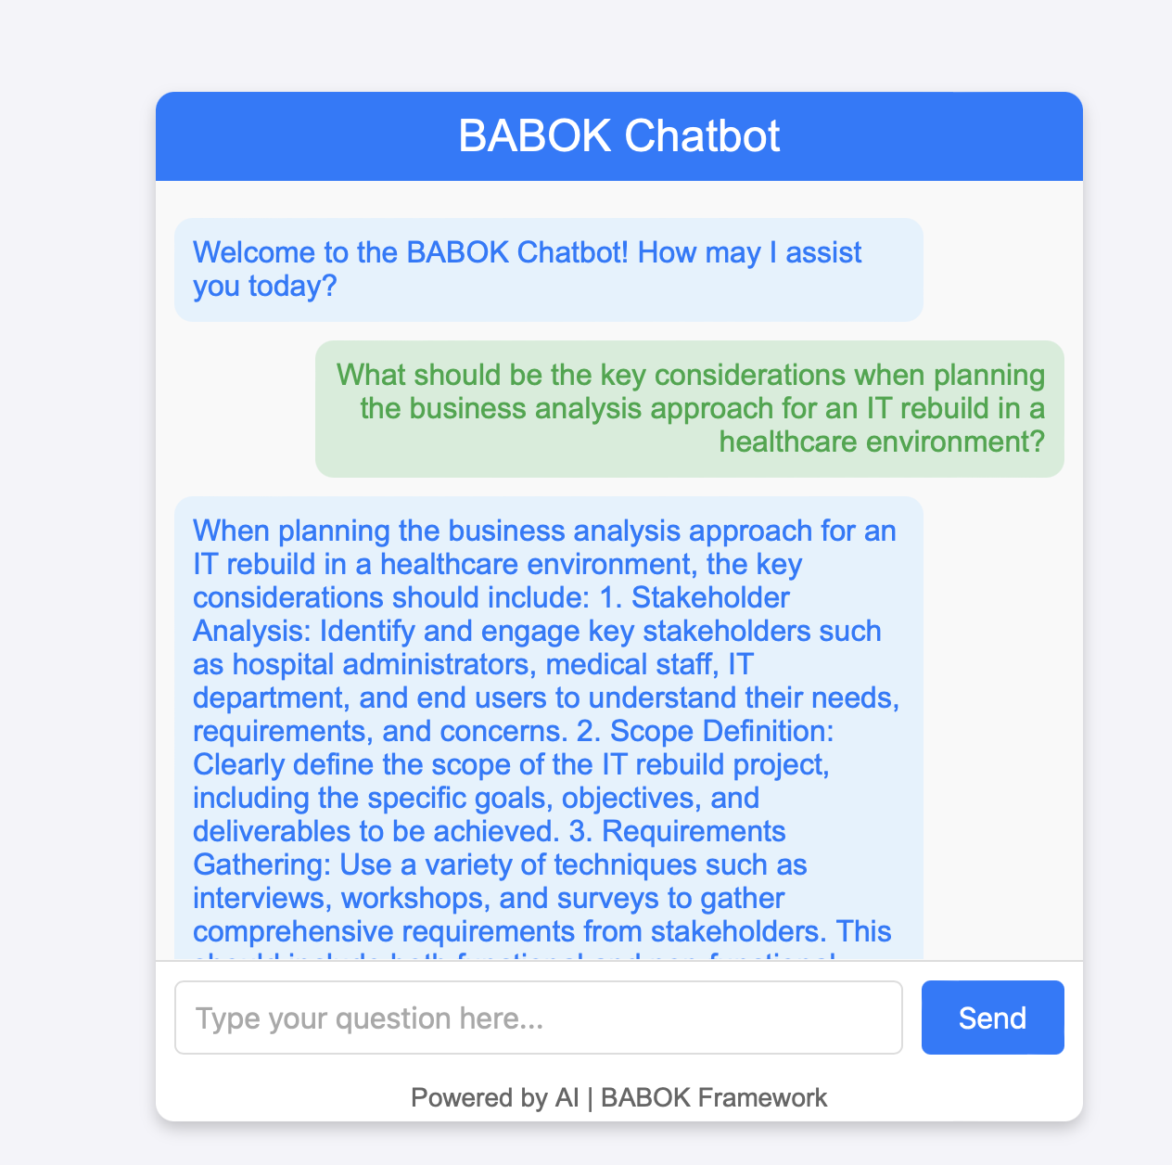
Results
1: Using Python
Source Link: http://192.168.1.107:5001/

Slide 10
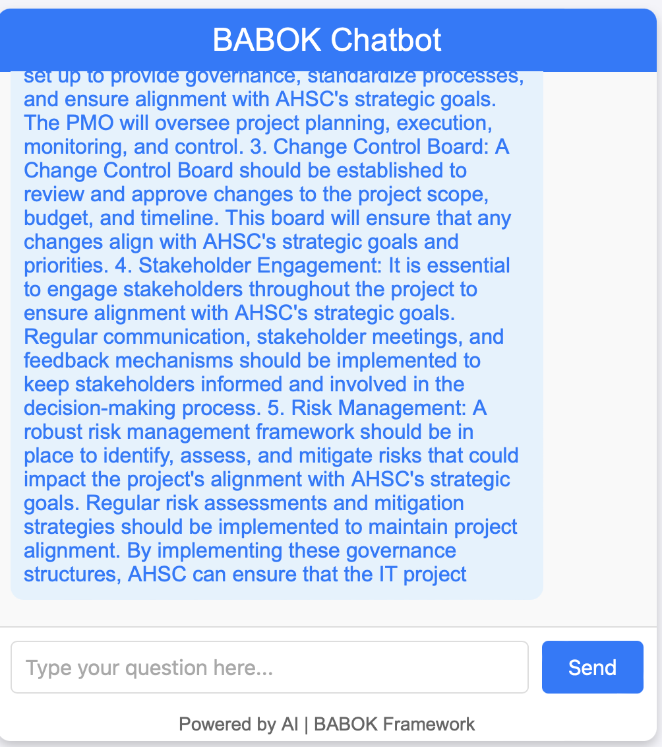
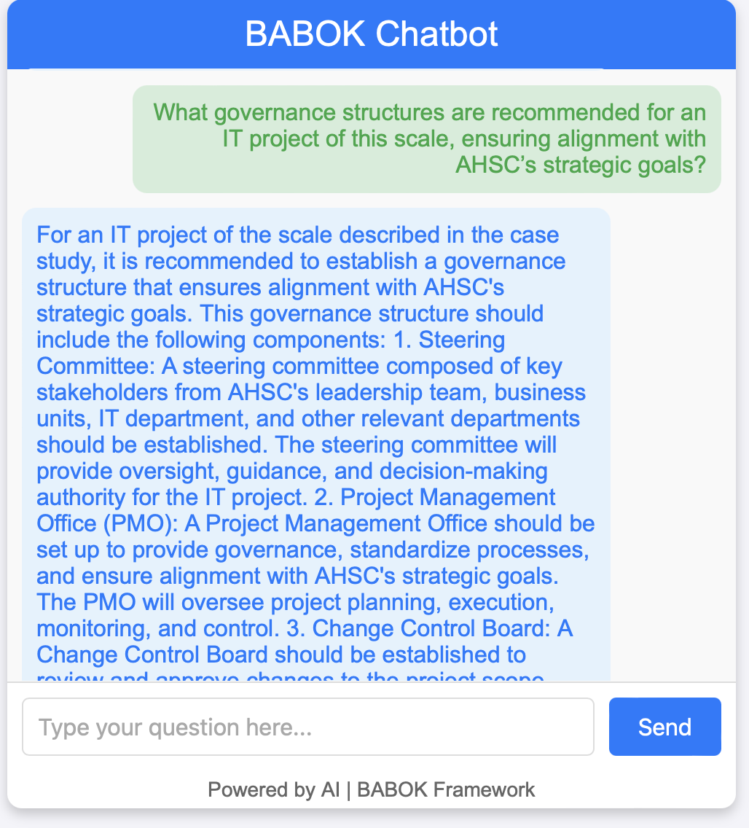
Results
1: Using Python
Source Link: http://192.168.1.107:5001/

Slide 11
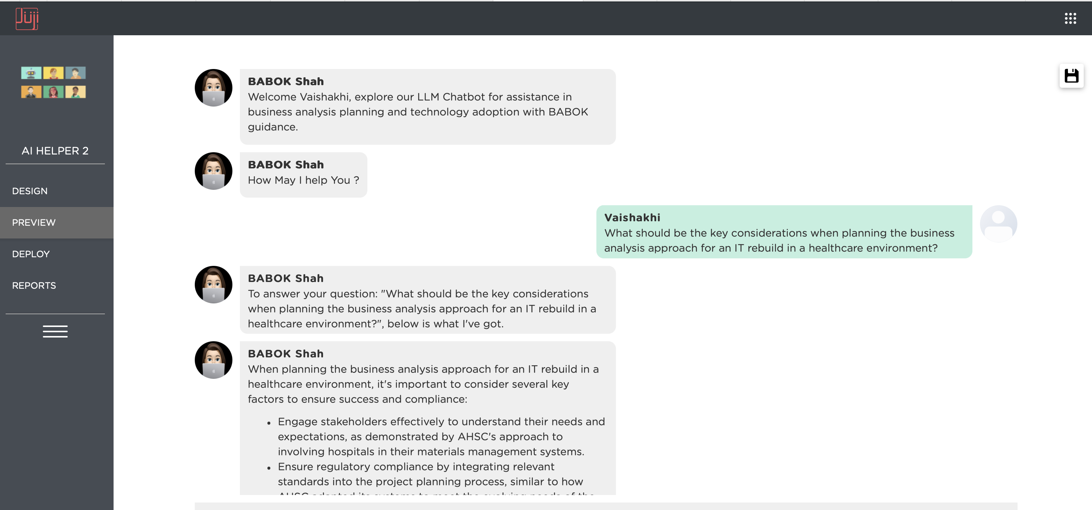
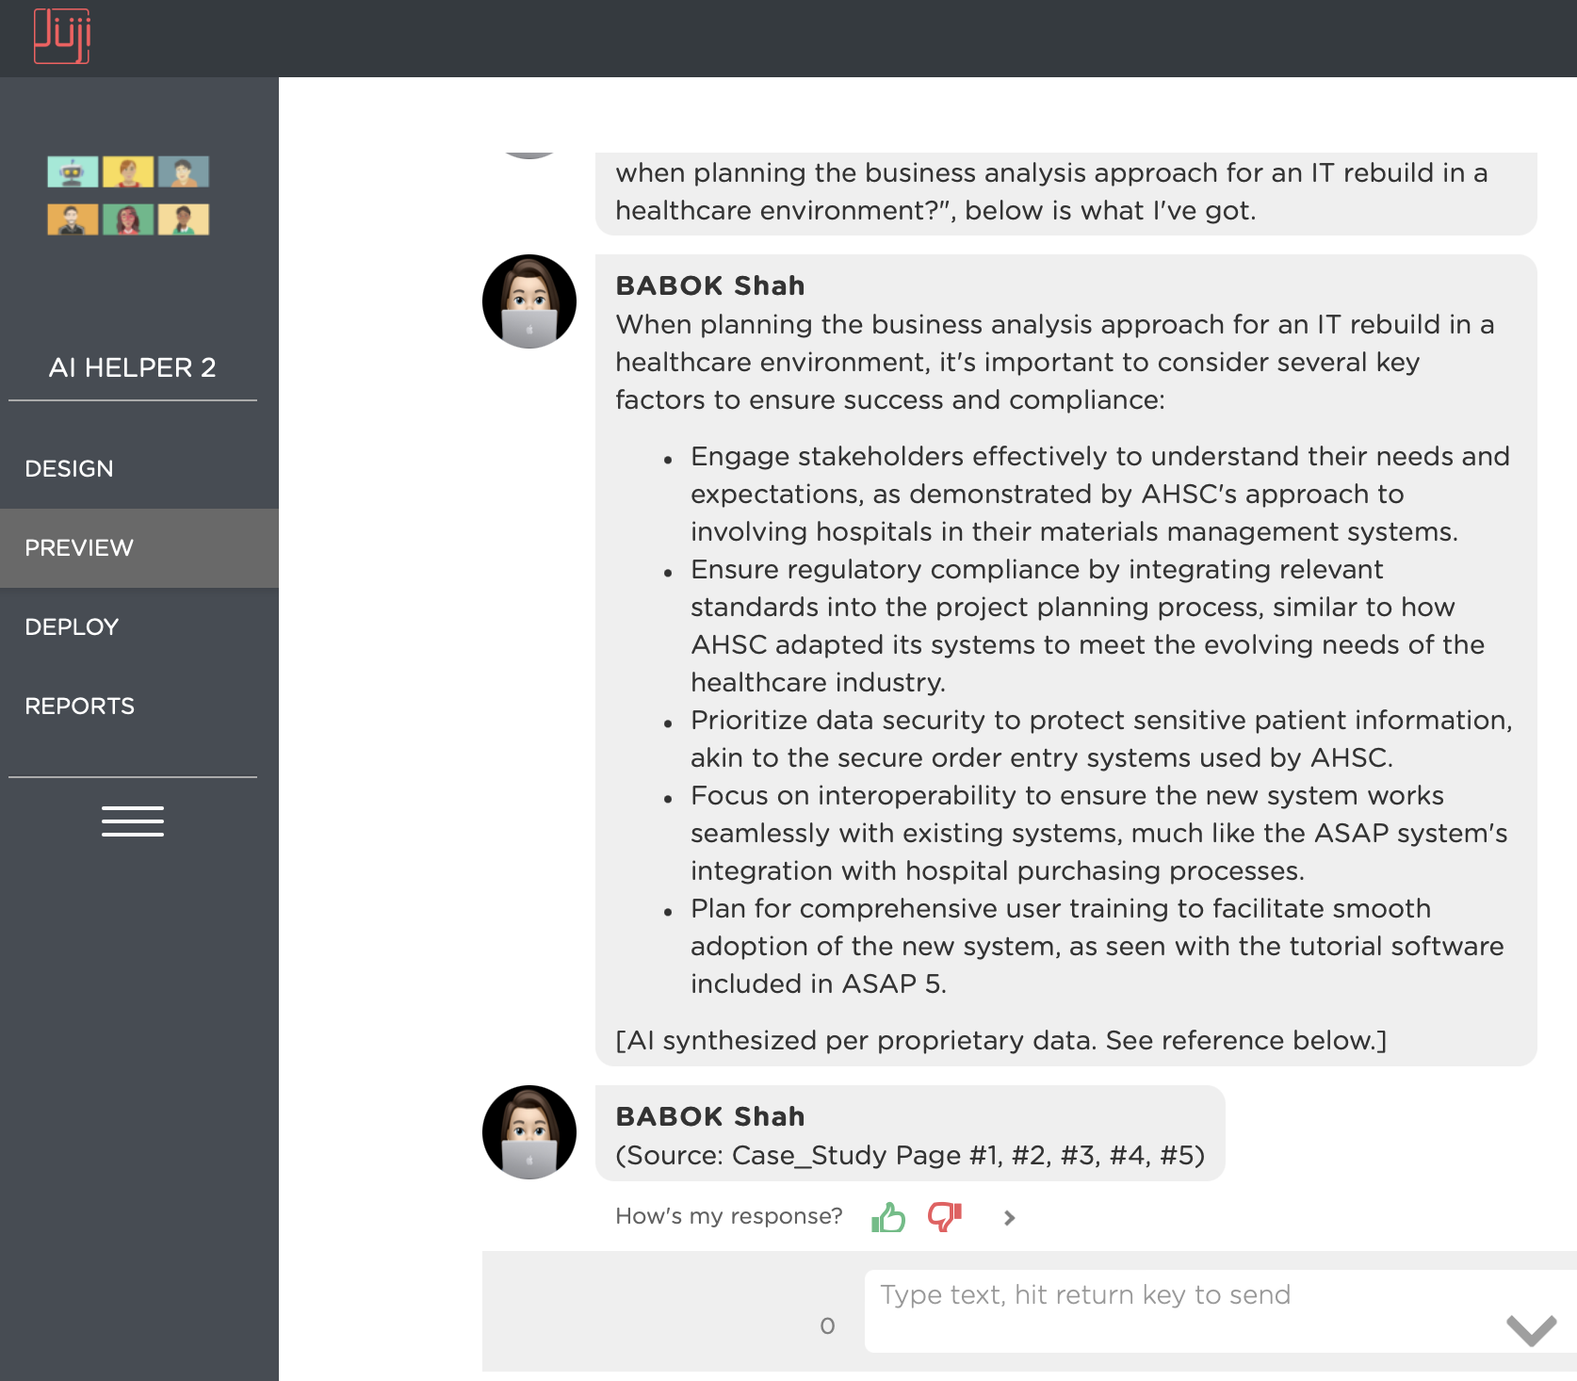
Results
2: Using Juji Studio
Source Link: https://juji.ai/rep/engagement/2/preview

Slide 12
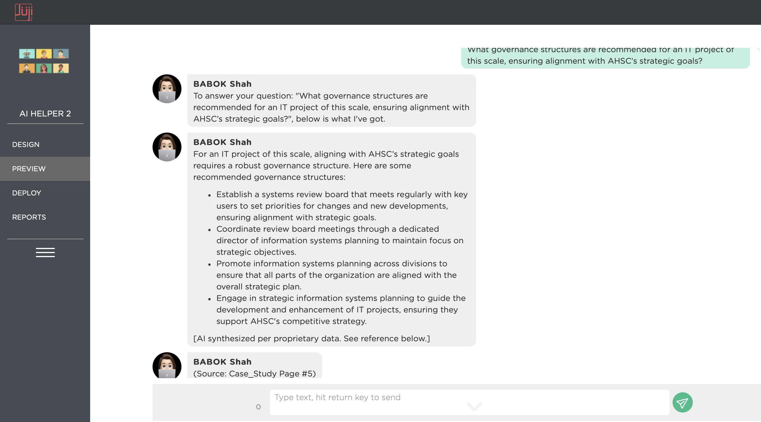
Results
2: Using Juji Studio
Source Link: https://juji.ai/rep/engagement/2/preview

Slide 13
Conclusions and Recommendations
Project Success Updates:
- Trial Testing of Business Case Scenario.
- Successful Chatbot Development and Deliverable with 2 different Proof of Concepts.
Next Steps:
- Future Improvements and Enhancements in the Chatbot.
- Testing on more case scenarios.

Slide 14
References
Chen, Y., Jensen, S., Albert, L. J., Gupta, S., & Lee, T. (2022). Artificial Intelligence (AI) Student Assistants in the Classroom: Designing Chatbots to Support Student Success. Information Systems Frontiers, 25, 161–182. https://doi.org/10.1007/s10796-022-10291-4
Chuma, E. L., & De Oliveira, G. G. (2023). Generative AI for business decision-making: A case of ChatGPT. Management Science and Business Decisions, 3(1), 5-11. https://doi.org/10.52812/msbd.63
Dam, S. K., Hong, C. S., Qiao, Y., & Zhang, C. (2024). A complete survey on llm-based ai chatbots. arXiv preprint arXiv:2406.16937. https://doi.org/10.48550/arXiv.2406.16937
Ferreira, D., Portela, F., & Santos, M. F. (2021). A step towards the use of chatbots to support the enterprise decision-making processes. In Trends and Applications in Information Systems and Technologies: Volume 4 9 (pp. 308-317). Springer International Publishing. https://doi.org/10.1007/978-3-030-72654-6_30
Goswami, I., & Gupta, D. (2024). Building and AI Chatbot using LLM.
Kumar, V., Srivastava, P., Dwivedi, A., Budhiraja, I., Ghosh, D., Goyal, V., & Arora, R. (2023, December). Large-Language-Models (LLM)-Based AI Chatbots: Architecture, In-Depth Analysis and Their Performance Evaluation. In International Conference on Recent Trends in Image Processing and Pattern Recognition (pp. 237-249). Cham: Springer Nature Switzerland. https://doi.org/10.1007/978-3-031-53085-2_20
Ngo Tran, G. T., Le Dinh, T., & Pham-Nguyen, C. (2024, August). BABot: A Framework for the LLM-Based Chatbot Supporting Business Analytics in e-Commerce. In International Conference on Computational Collective Intelligence (pp. 185-198). Cham: Springer Nature Switzerland. https://doi.org/10.1007/978-3-031-70816-9_15

Slide 15



Thank You !
Vaishakhi Shah
Project Manager and Consultant
New York University, Management and Systems (Database Technology)
Treasurer, Management and Systems Student Association (MSSA)
Mobile: +1-732-839-5566 | Email: vs2896@nyu.edu |LinkedIn

